Slide 1


SMART INDIA HACKATHON 2025
SANKALP
Problem Statement ID– SIH25073
Problem Statement Title- AI-Powered Mobile Platform for Democratizing Sports Talent Assessment
Theme- Fitness & Sports
PS Category- Software
Team ID-
Team Name- Sankalp

Slide 2
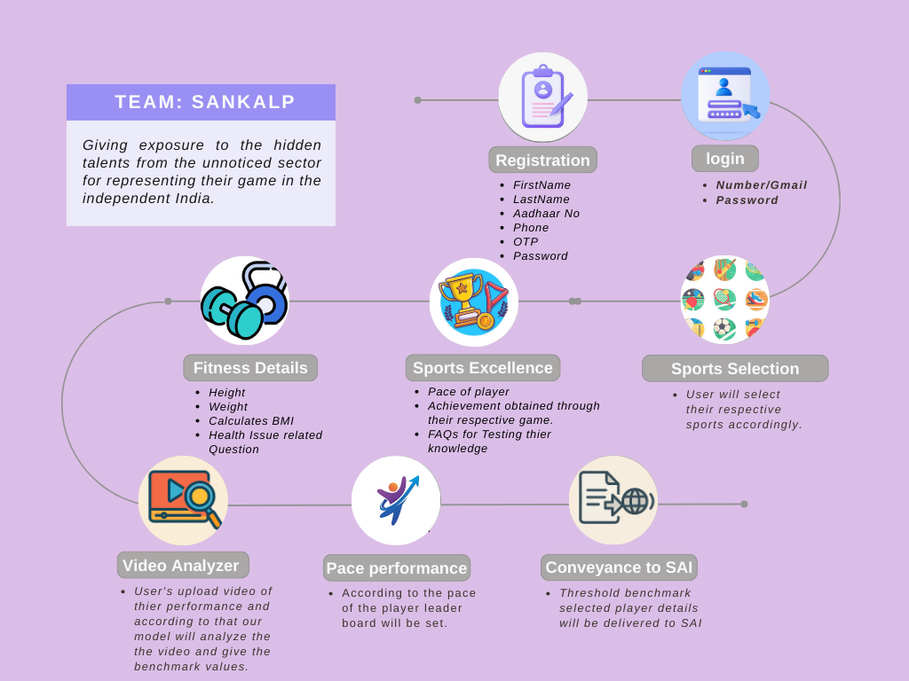
ATHLETE EXPOSURE BEYOND LIMITS
Sankalp
Proposed Solution:
AI-Powered Sports Talent Identification App
User registration: User can get into the process by giving its credentials like username, Aadhaar number along with phone number, OTP and password .
Login: The user can fill its username and password to ahead of the process.
Sport & category selection: Player select their respective game and the pace like Beginner, Medium, Advanced.
Achievement: The user can first appear their FAQ and
then upload their document of excellence.
Upload fitness + game videos via webcam
Video Analyzer: AI evaluates performance & detects fraud.
Performance Evaluation: Leaderboards generated by category.

Slide 3
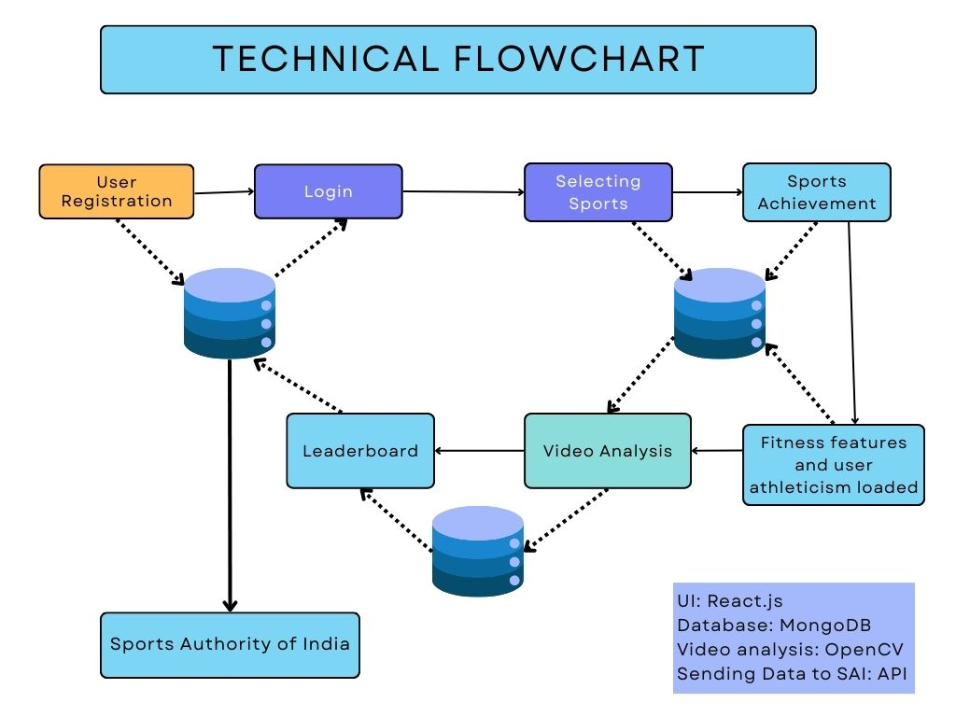

















TECHNICAL APPROACH
Sankalp
Frontend: React Js, React Native, Next Js, Tailwind CSS
Backend: Node.js, Express Js, REST API
Database: MongoDB
AI and ML: OpenCV (video analysis), MediaPipe, PyTorch for custom ML models
API Services: SAI APIs, FAST API, Flask / FastAPI, Gmail, MongoDB Atlas API, MediaPipe Pose API, cv2 API, PyTorch API
Cloud and Deployment: AWS / Azure, GitHub, Vercel

Slide 4





FEASIBILITY AND VIABILITY
Sankalp
Feasibility:
Technical: Utilizing existing technologies(web, AI/ML, mobile)
Modularization: All the modular design allows phased implementation
Market: Rising of AI in sports and athletes which will make this project more attractive for the Indian Government
Economic: Low investment with cloud-based infrastructures.
Solutions:
Implement strong encryption and follow along with data protection regulations
Utilize a clean UI, multilanguage option and a leaderboard with achievement badges and progress tracking
Developing flexible APIs with SAI for seamless integration
Initiate a dedicated team for get updated with the technologies and improve platform.
Viability:
Government Alignment: It will support Sports Authority of India, Khelo India, State Sport Council
Large potential User base: Numerous Athletes across India seeking exposure.
Scalable: Can start from minority of sports to multiple sports categories.
Use Cases:
Rural athlete can showcase their talent to get a exposure.
Sport India Authority will use the dashboard for evaluating the athlete.
Coaches will get athlete analyzed data for better evaluation.
Athlete always will be going to receive feedback about their performance
Challenges:
Privacy: Data privacy and security concern
User Experience: User adoption and sustained engagement
Integration: Integrating athlete data with SAI database
Evolution: Changes in AI/ML models technologies

Slide 5
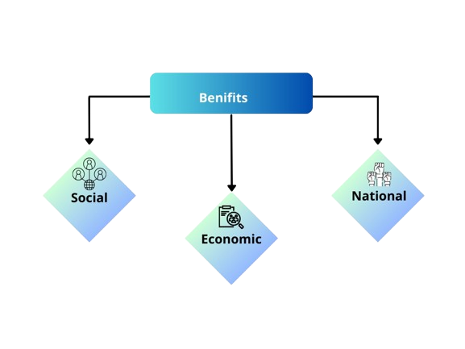
IMPACT AND BENEFITS
Sankalp
Benefit for the solution
Social :
This solution will give fair chances and opportunities to athlete to showcase their talent.
It will bring every athletes to give equal opportunities with out any partiality.
Motivate young youth to participate in sports.
Economic :
Reduce wastage of money by focusing on genuine talent.
Helps the nation to build a robust sports system.
It will also help athletes to get jobs it sports quota.
Nation :
Find athletes and train them for representing their nation in national, international level.
Improves India’s Pride in Global Sport Events like in Olympics.
Potential impact on the target audience
Provides a path to for ground level athlete to reach Higer level.
It will boost the confidence of the athlete.
The athletes which are selected can contribute our country for long term.
Athletes will recognize their strength and also work on improvement.

Slide 6

RESEARCH AND REFERENCES
Sankalp
AI-based sports analytics research papers.
Kaggle datasets on fitness & performance analysis and benchmark
Source of the data set: Link
Case studies of AI in global sports talent identification
Sports Authority of India (SAI) talent scouting guidelines - Link

